Slide 1
An
inside
view on
Azure
DevOps
Valmir Meneses

Slide 2


An inside view on Azure DevOps
An inside view on Azure DevOps
1. Someone’s knocking at the door... Get/provide access to ADO by PAT
2. Who are you … who, who? Use the PAT to access ADO
3. I couldn't love you any better I love you just the way you are ADO Analytics from Power BI
4. The secret is about to unfold, Upstairs before the night's too old Access ADO using OData
5. giMMe shelter The available tables with M
6. Ob-La-Di, Ob-La-DAX Calculated columns
7. Oh, I believe in yesterday Query the history of Work Items
8. Time is on my side Sprint creation script

Slide 3
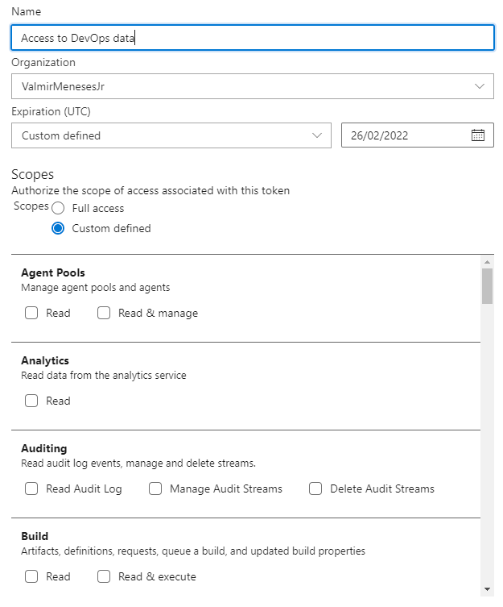
“…Someone's knocking at the door. Somebody's ringing the bell Do me a favor Open the door and let 'em in, yeah, yeah, yeah, yeah, yeah” Let 'Em In by Wings ,circa 1976
Azure DevOps data access can be done by Personal Access Tokens.
The token can be created with very specific permissions. Currently, there are 43 scopes for the permissions
https://docs.microsoft.com/en-us/azure/devops/organizations/accounts/use-personal-access-tokens-to-authenticate?

Slide 4
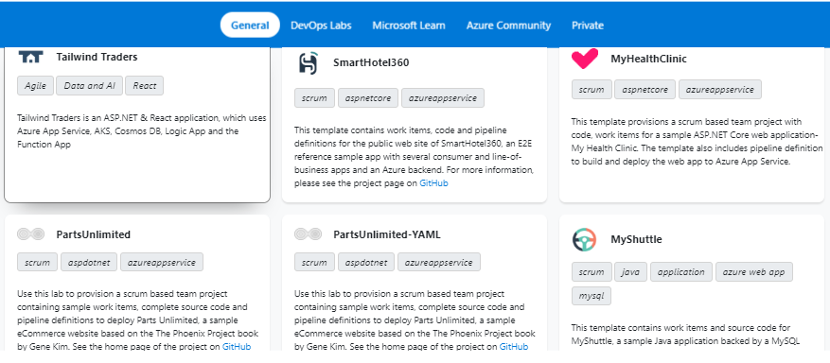
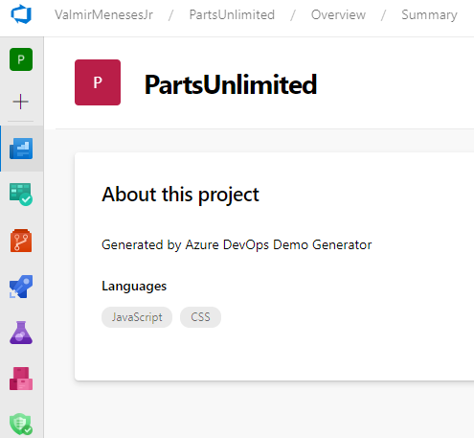
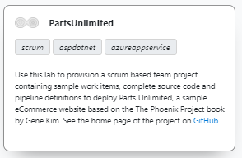
Bonus track “…Hey (hey), you (you). Get off of my cloud…”
Get off of my cloud by The Rolling Stones, circa 1965
Azure DevOps Demo Generator https://azuredevopsdemogenerator.azurewebsites.net/
Diverse templates choice:

Slide 5
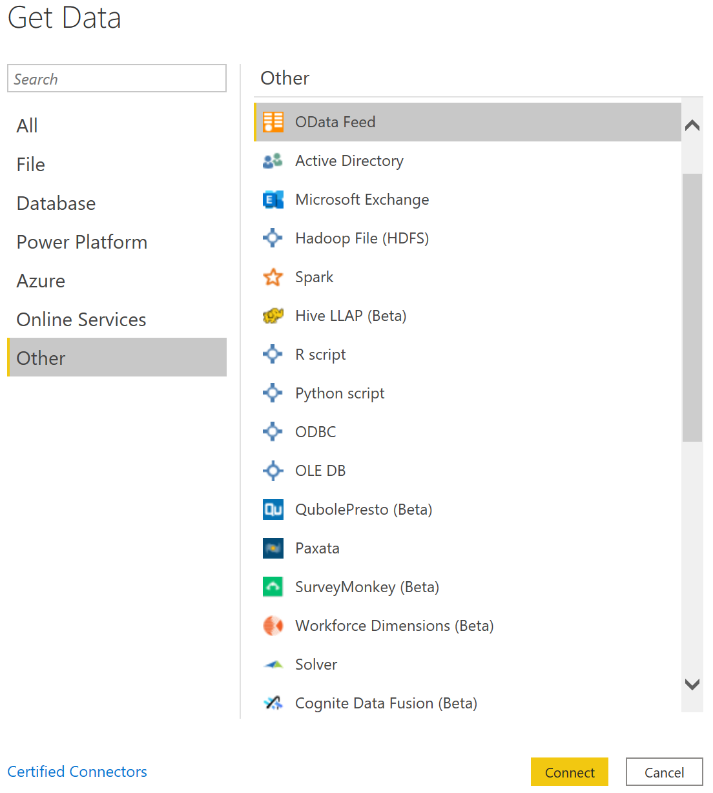
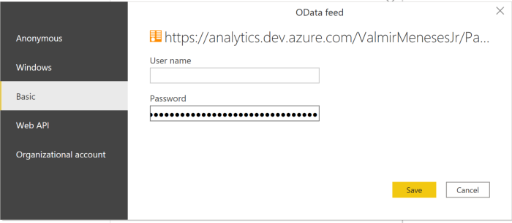
“Who are you? Who, who, who, who?”
Who are you by The Who ,circa 1978
When connecting with a PAT, choose Basic Authentication.
User Name = (empty)
Password = PAT
There is a difference between the ways you connect with Power BI.
As Odata Feed, you will be able to see most of the data stored in ADO and create your own Key Indicators.
https://docs.microsoft.com/en-us/azure/devops/report/powerbi/data-connector-dataset?view=azure-devops

Slide 6
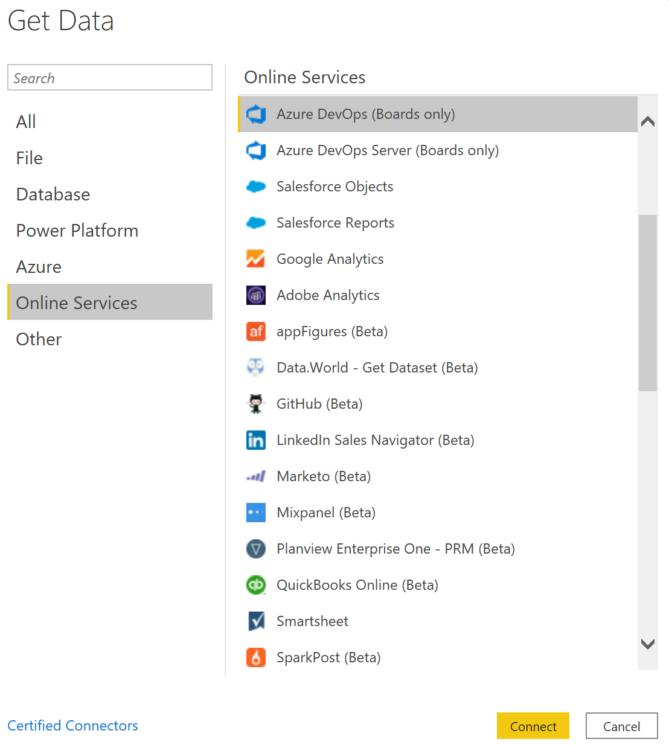
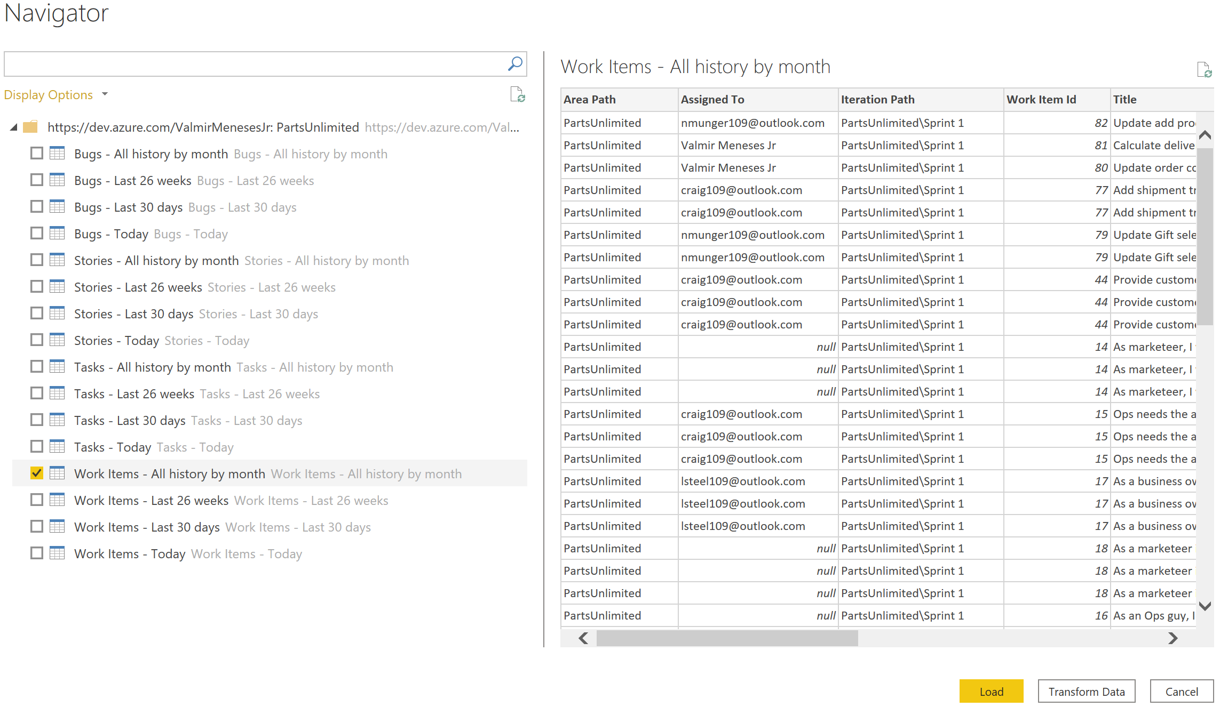
“I couldn't love you any better , I love you just the way you are …”
Just the way you are by Billy Joel, circa 1977
As an Online Services, you will be able to see Boards Only data.

Slide 7
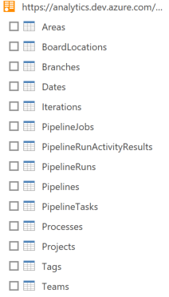
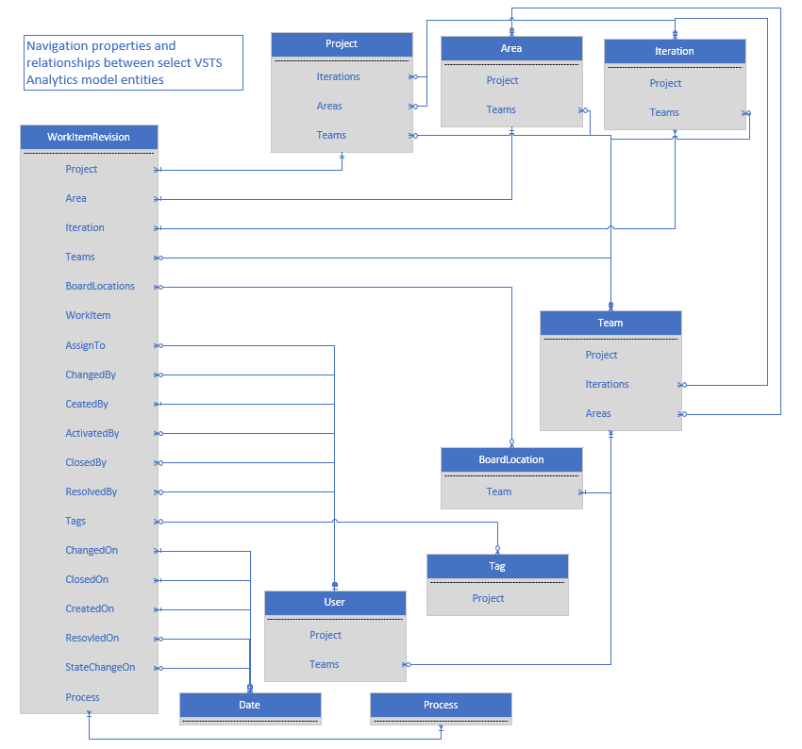
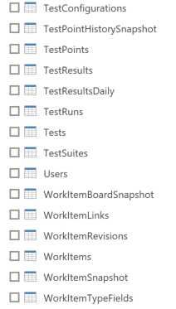
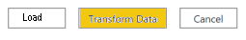
“…The secret is about to unfold, Upstairs before the night's too old…”
Tonight’s the night (Gonna Be Alright) by Rod Stewart , circa 1976
As OData, you will be able to see it all
Transform data option will give you more flexibility!
https://docs.microsoft.com/en-us/azure/devops/report/extend-analytics/data-model-analytics-service?view=azure-devops

Slide 8
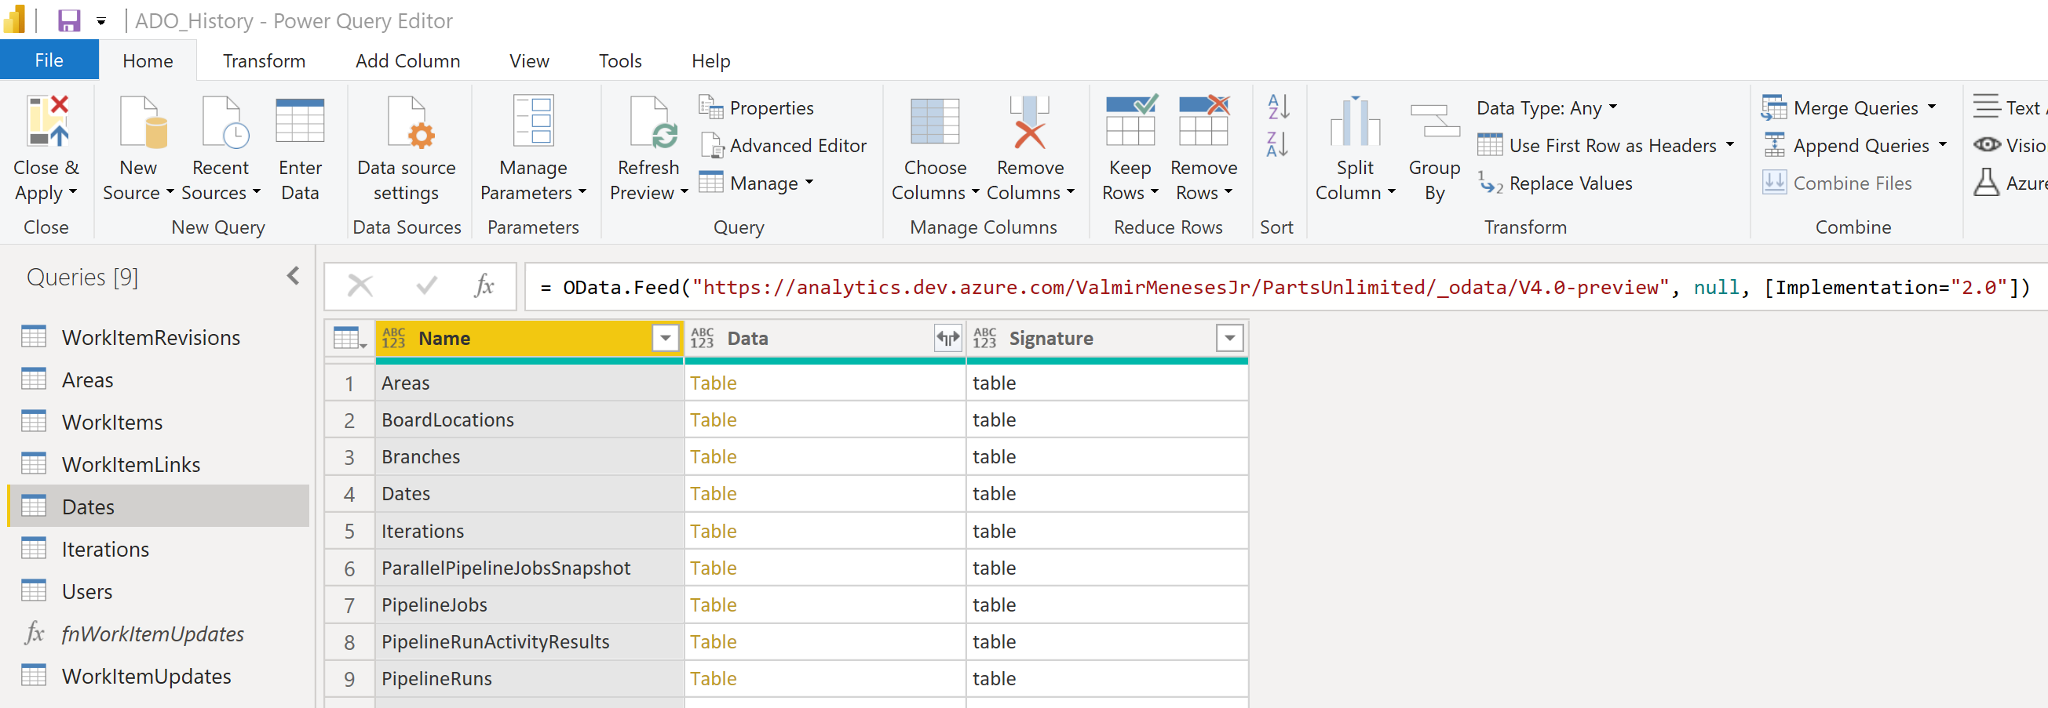
“I tell you love… sister… It's just a kiss away”
GiMMe Shelter by The Rolling Stones , circa 1969
For each entity that you've selected, Power Query creates a query. Each query must be updated manually, because doing so prevents throttling errors.
Power Query attempts to resolve null values as errors by generating an additional query for every null value it encounters.
This can result in thousands of queries, which will quickly exceed your usage threshold, beyond which your user account will be throttled.
<entity>Snapshot will depict the daily state of an entity as opposed to the current state. Beware of the size!
Replace [Implementation="2.0"] with the following string: [Implementation="2.0",OmitValues = ODataOmitValues.Nulls,ODataVersion = 4]
https://docs.microsoft.com/en-us/azure/devops/report/powerbi/access-analytics-power-bi?view=azure-devops
Query guidelines at
https://docs.microsoft.com/en-us/azure/devops/report/extend-analytics/odata-query-guidelines?view=azure-devops

Slide 9
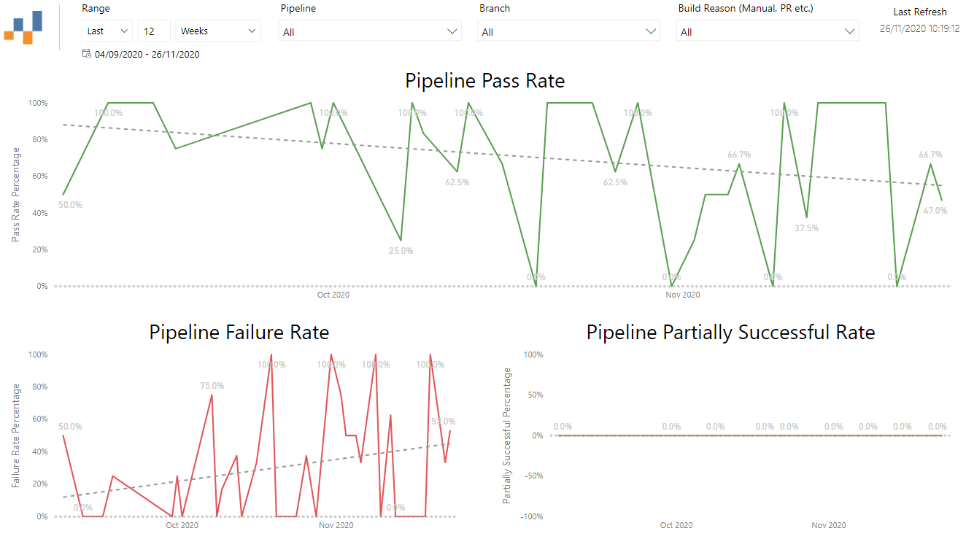
“I tell you love… sister… It's just a kiss away”
Gimme Shelter by The Rolling Stones , circa 1969
Azure Boards | Azure Test Plans | Azure Pipelines | Azure Pipeline & Test
Open Bugs | Progress Status | Outcome Summary | Test Summary
Bug Trend | Requirements Tracking & Traceability | Outcome Summary for all Pipelines | Test Summary Trend
Rollup | Test Status Report | Pass Rate Trend | Failed Tests
Feature Progress | Test Execution Trend | Stage/Task/Job Wise Failures | Flaky Tests
Work Items With Direct Links | Test Suites Aggregated View | Pipeline Duration | Test Duration
Sprint Burndown | Tester by Outcome Matrix | Duration Trend | Test Duration Trend
Cumulative Flow Diagram (CFD) | Test Configuration Outcome Matrix | Task Duration | Pass Rate Trend of a Test
Lead/Cycle Time |  | Task Duration Trend
Sample reports available
https://github.com/nbrown02/AzureDevOps-OData-SampleReports

Slide 10
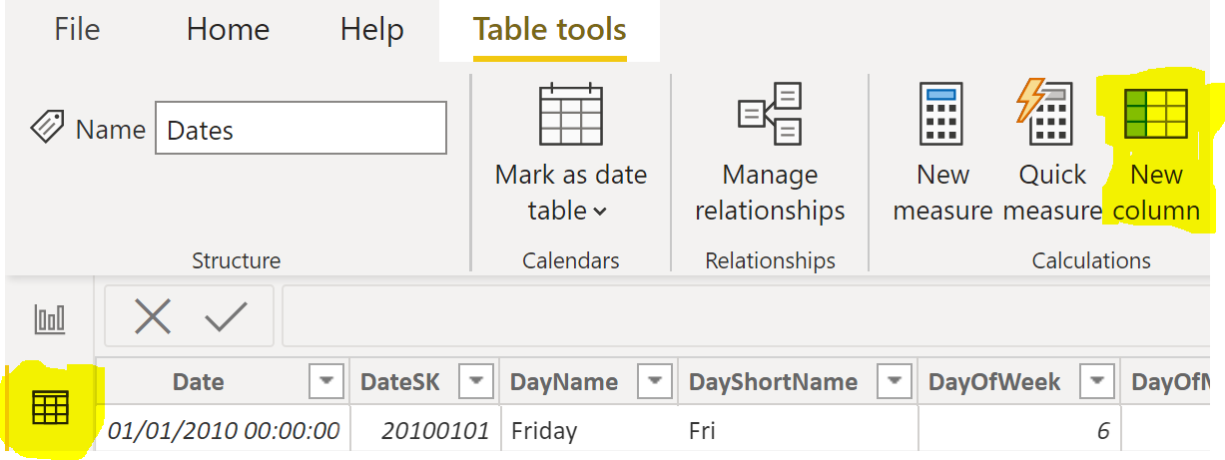
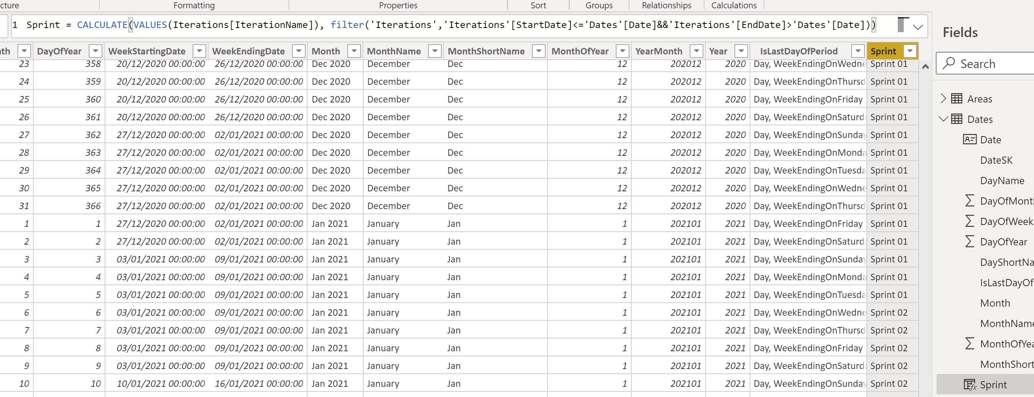
“Yeah! Ob-la-di, ob-la-DAX, Life goes on”
Ob-La-Di, Ob-La-Da by The Beatles, circa 1968
The dates in the entities columns are in a regular date format but it is quite useful if we can refer to the dates as a sprint period.
New column icon or right-click on the Dates Table + New Column
In Data view
Click on Dates
table
Sprint = CALCULATE(VALUES(Iterations[IterationName]),
filter('Iterations','Iterations'[StartDate]<='Dates'[Date]
&&'Iterations'[EndDate]>'Dates'[Date]))

Slide 11
“Yeah! Ob-la-di, ob-la-DAX, Life goes on”
Ob-La-Di, Ob-La-Da by The Beatles, circa 1968
And now the same “dance move” for the WorkItems table. Some useful Key Indicators and Hacks
US closed only in Planning next sprint
InProgressSprint = LOOKUPVALUE(Dates[Sprint],Dates[DateSK],WorkItems[InProgressDateSK])
CompletedSprint = LOOKUPVALUE(Dates[Sprint],Dates[DateSK],WorkItems[CompletedDateSK])
ActivatedSprint = LOOKUPVALUE(Dates[Sprint],Dates[DateSK],WorkItems[ActivatedDateSK])
ClosedSprint = LOOKUPVALUE(Dates[Sprint],Dates[DateSK],WorkItems[ClosedDateSK])
ClosedLateSprint = LOOKUPVALUE(Dates[Sprint],Dates[DateSK],VALUE(Format(WorkItems[ClosedDate]-1,"yyyyMMdd")))
ResolvedSprint = LOOKUPVALUE(Dates[Sprint],Dates[DateSK],WorkItems[ResolvedDateSK])
CreatedSprint = LOOKUPVALUE(Dates[Sprint],Dates[DateSK],WorkItems[CreatedDateSK])
Team=LOOKUPVALUE(Areas[AreaPath],Areas[AreaSK],WorkItems[AreaSK])
AssignedTo=LOOKUPVALUE(Users[UserName],Users[UserSK],WorkItems[AssignedToUserSK])
ActivatedBy=LOOKUPVALUE(Users[UserName],Users[UserSK],WorkItems[ActivatedByUserSK])
CreatedBy=LOOKUPVALUE(Users[UserName],Users[UserSK],WorkItems[CreatedByUserSK])
ResolvedBy=LOOKUPVALUE(Users[UserName],Users[UserSK],WorkItems[ResolvedByUserSK])
Iteration=LOOKUPVALUE(Iterations[IterationName],Iterations[IterationSK],WorkItems[IterationSK])
ClosedSprintPeriod = WorkItems[ClosedLateSprint] & " (" & Format(LOOKUPVALUE(Iterations[StartDate],Iterations[IterationName],WorkItems[ClosedLateSprint]),"mmm/dd") & " to "
& Format(LOOKUPVALUE(Iterations[EndDate],Iterations[IterationName],WorkItems[ClosedLateSprint]),"mmm/dd") & " )"
UserStory = IF(WorkItems[WorkItemType]="User Story",1,0)
UserStoryInSprint = IF(WorkItems[ActivatedSprint]=WorkItems[ClosedLateSprint],1,0)
US_StoryPoints = IF(WorkItems[StoryPoints]<1,2, WorkItems[StoryPoints])
StoryPointsInSprint = WorkItems[US_StoryPoints]*WorkItems[UserStoryInSprint]
US closed in the same sprint it was activated

Slide 12
“Yeah! Ob-la-di, ob-la-DAX, Life goes on”
Ob-La-Di, Ob-La-Da by The Beatles, circa 1968
Build your own tree
Parent = CALCULATE(VALUES(WorkItemLinks[SourceWorkItemId]), filter('WorkItemLinks','WorkItemLinks'[LinkTypeName]="Child" && 'WorkItemLinks'[TargetWorkItemId]=WorkItems[WorkItemId]))
ParentPath = Path(WorkItems[WorkItemId],WorkItems[ParentWorkItemId])
Depth = PATHLENGTH(WorkItems[ParentPath] )
Level1 =
VAR LevelNumber = 1
VAR LevelKey = PATHITEM ( WorkItems[ParentPath], LevelNumber, INTEGER )
VAR LevelName = LOOKUPVALUE ( WorkItems[Title], WorkItems[WorkItemId], LevelKey )
VAR Result = LevelName
RETURN
Result
Level2 =
VAR LevelNumber = 2
VAR LevelKey = PATHITEM ( WorkItems[ParentPath], LevelNumber, INTEGER )
VAR LevelName = LOOKUPVALUE ( WorkItems[Title], WorkItems[WorkItemId], LevelKey )
VAR Result = LevelName
RETURN
Result

Slide 13
“Oh! I believe in yesterday”
Yesterday by The Beatles, circa 1965
Leading Edge Delivery principle: Use telemetry to fundament actions.
Azure DevOps UI query builder does not allow some constructions:
How long was a task in Blocked state?
Which USs returned to the Product backlog after being assigned to a sprint?
Which USs had the priority updated?
Which USs had the estimate updated?
Which USs have not been updated in the last 5 days?
Which USs changed the Assigned team member?

Slide 14
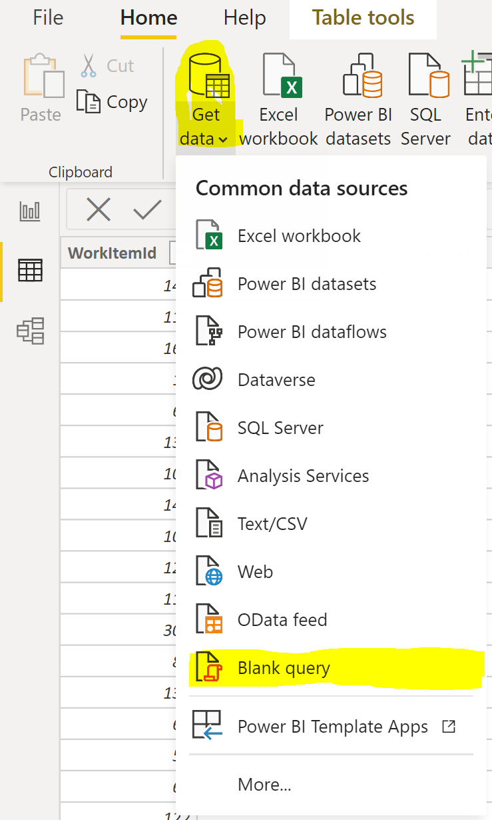
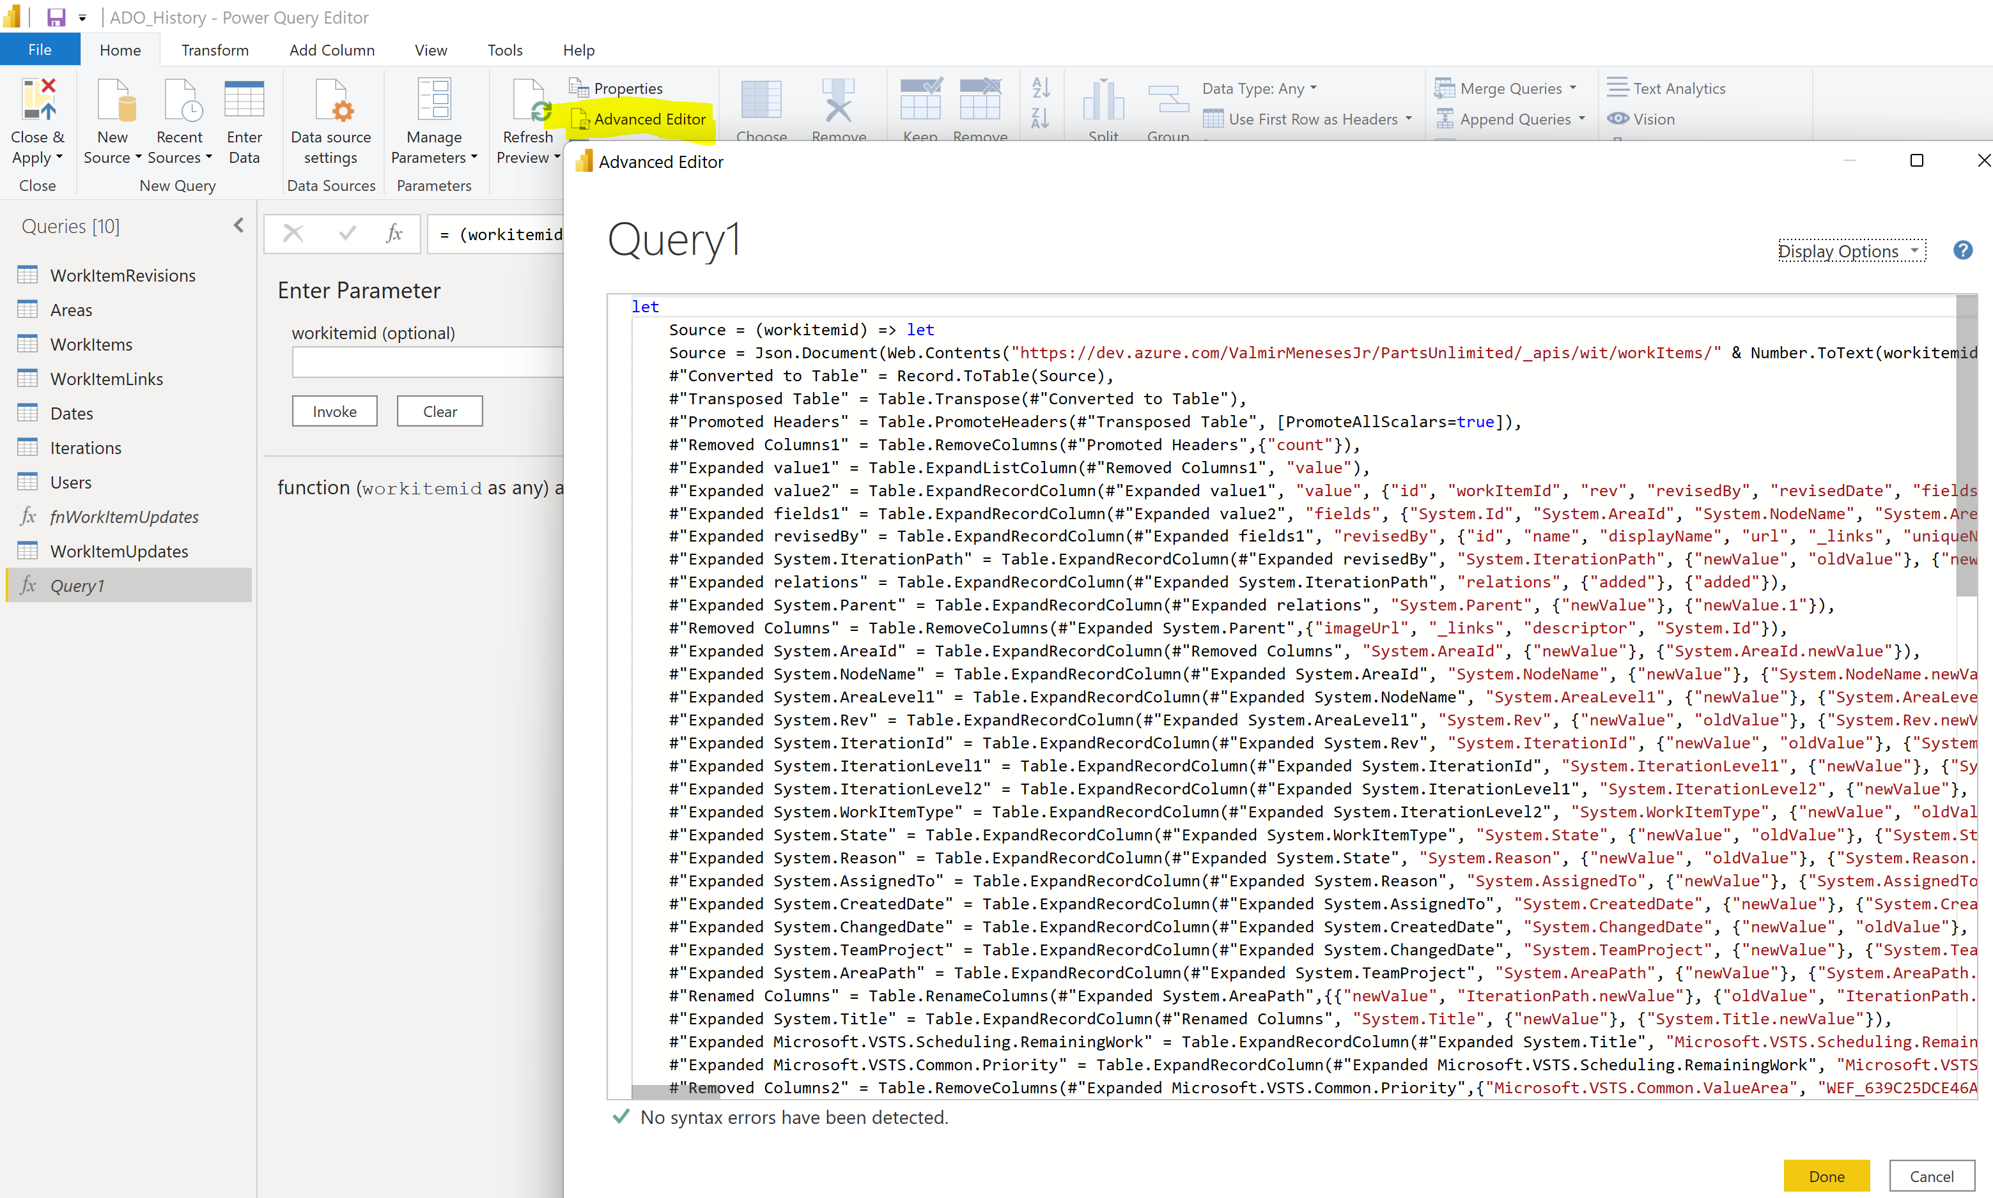
“Oh! I believe in yesterday”
Yesterday by The Beatles, circa 1965
In the Power Query Editor, choose Advanced Editor and copy the contents of the function code.
Rename Query1 to fnWorkItemUpdates.
Enter 253 in the
Parameter and invoke.

Slide 15
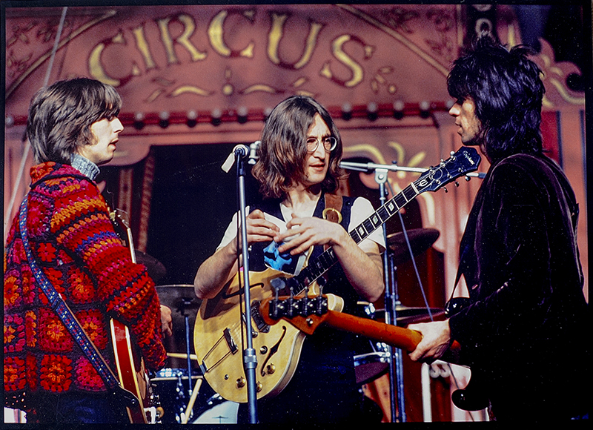
“Oh! I believe in yesterday”
Yesterday by The Beatles, circa 1965
let
Source = (workitemid) =>
let
Source = Json.Document(Web.Contents("https://dev.azure.com/ValmirMeneses/PartsUnlimited/_apis/wit/workItems/" & Number.ToText(workitemid) & "/updates?api-version=6.0")),
#"Converted to Table" = Record.ToTable(Source),
#"Transposed Table" = Table.Transpose(#"Converted to Table"),
#"Promoted Headers" = Table.PromoteHeaders(#"Transposed Table", [PromoteAllScalars=true]),
#"Removed Columns1" = Table.RemoveColumns(#"Promoted Headers",{"count"}),
#"Expanded value1" = Table.ExpandListColumn(#"Removed Columns1", "value"),
The Core of the function, a REST API call.
The remaining code is JSON juggling!
Eric Clapton, John Lennon and Keith Richards in Rock’n roll circus

Slide 16
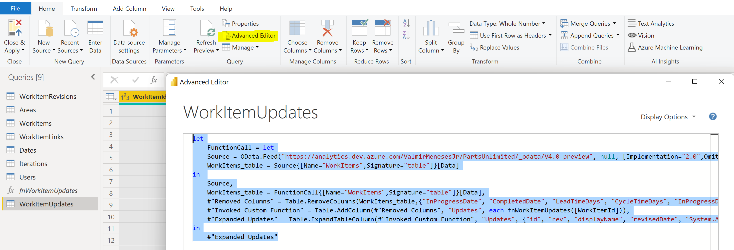
“Oh! I believe in yesterday”
Yesterday by The Beatles, circa 1965
Create another blank query, click Advanced Editor and enter the definition for WorkItemUpdates table
Function call

Slide 17
“Time is on my side”
Time is on my side by The Rolling Stones, circa 1965
Every time that we need to start new projects on Azure DevOps, it’s necessary to create iterations. Often, we have created some iterations with 2 weeks each, where we must repeat this same procedure regarding the number of sprints needed for our project.
Param
(
[string]$PAT=‘xxxxxxxxxxxxxxxxxxxxxxxxxxxx',
[string]$Organization='https://dev.azure.com/ValmirMenesesJr',
[string]$Project='PartsUnlimited',
[string]$TeamName='PartsUnlimited Team',
[DateTime]$StartDate='2022-02-03',
[int]$NumberOfSprints=1,
[int]$SprintStartingNumber=30
)
echo $PAT | az devops login --org $Organization
Write-Host '===Configuring connection to organization and Team Project'
az devops configure --defaults organization=$Organization project=$Project
For ($i=1; $i -le $NumberOfSprints; $i++)
{
$SprintNumber = $SprintStartingNumber+($i-1)
$Sprint = 'Sprint ' + '{0:d2}' -f $SprintNumber
$StartDateIteration = $StartDate.AddDays(($i - 1) * 14)
$FinishDateIteration = $StartDateIteration.AddDays(13)
$createIteration = az boards iteration project create --name $Sprint --start-date $StartDateIteration --finish-date $FinishDateIteration --org $Organization --project $Project 3>$null | ConvertFrom-Json
$addIteration = az boards iteration team add --id $createIteration.Identifier --team $TeamName --org $Organization --project $Project 3>$null| ConvertFrom-Json
Write-Host $addIteration.name 'created on path'$addIteration.path
}
Full Access PAT
https://github.com/vinijmoura/Azure-DevOps

Slide 18
Thank You!

Slide 19
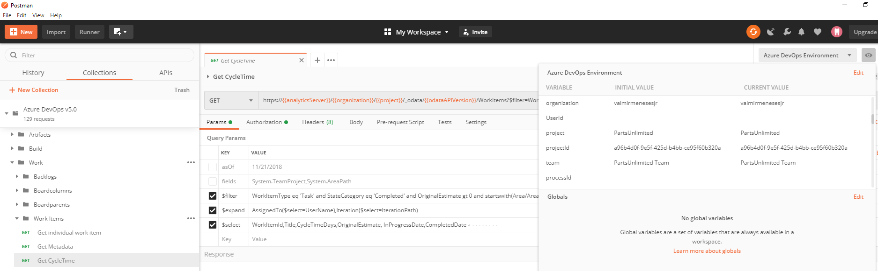
The PostMan application can be very useful to use the REST API option
It provides Collections (pre-written calls) and Environments (variables to each ADO project)
{"@odata.context":"https://analytics.dev.azure.com/ValmirMenesesJr/PartsUnlimited/_odata/v3.0-preview/
$metadata#WorkItems(WorkItemId,Title,CycleTimeDays,OriginalEstimate,InProgressDate,CompletedDate,AssignedTo(UserName),Iteration(IterationPath))",
"value":[
{"WorkItemId":6960,
"InProgressDate":"2019-11-04T09:57:50.98Z",
"CompletedDate":"2019-11-05T11:30:05.93Z",
"CycleTimeDays":1.0640625,
"Title":"Clarifying Data Architecture",
"OriginalEstimate":1.0,
"AssignedTo":{"UserName":"Valmir Meneses"},
"Iteration":{"IterationPath":"PartsUnlimited\\Sprint 16"}},
{"WorkItemId":11189,
"InProgressDate":"2020-02-06T08:23:57.74Z",
"CompletedDate":"2020-02-12T08:19:58.287Z",
"CycleTimeDays":5.9972337,
"Title":"Provide answers to IF Data Access Management first iteration round requests",
"OriginalEstimate":4.0,
"AssignedTo":{"UserName":"Valmir Meneses"},"Iteration":{"IterationPath":"PartsUnlimited\\Sprint 16"}},
The output is usually a JSON file that can be parsed to the desired destination for reporting
https://analytics.dev.azure.com/ValmirMeneses/PartsUnlimited/_odata/V4.0-preview/$MetaData

Slide 20
To setup the Postman collections follow these steps:
Download and register for Postman from their website
Click File | Import ....
Select Import From Link.
Paste the following two URLs and click Import after each.
https://raw.githubusercontent.com/hkamel/azuredevops-postman-collections/master/Azure%20DevOps%20v5.0.postman_collection.json
https://raw.githubusercontent.com/hkamel/azuredevops-postman-collections/master/Azure%20DevOps%20Environment.postman_environment.json
You should now see the Azure DevOps v5.0 collection on the left had side Collections pane.
Click on the No environment drop down in top right hand corner.
Select Azure DevOps Environment.
Click the eye icon to the the right and then click Edit.
Enter in to the current (not initial) variables your Azure DevOps organization name: Organization, AccessToken ad Api-version.
By default, the requests will go to the cloud hosted Azure DevOps.
If you want to use it for an on-prem instance, change the coreServer URL as required.
If they are all the same, you can update coreServer with dev.azure.com and then update the other variables.
Select Update. Close the Manage Environments dialog.
Expand the Core | Projects folder and click on List all projects. Then Click the Send button.
You are now up and running with Azure DevOps postman collections.

Slide 21
Some feature or tools could be useful to a Scrum Master or Dev / Tech Lead role:
Tag the higher hierarchies work items to show there is a blocked task in that workstream;
Create a visual link between dependent Features/deliverables;
Optionally move higher hierarchies work items (avoid unparented tasks in a sprint backlog if US is another sprint);
Create Activity (Testing, Development, Deployment) metrics or Burndown chart;
Export WIKI documentation branch to PDF/Word;
Update lower or higher hierarchies dates for delivery when work item is delayed/postponed (E.g. like in MS Project)

Slide 22
Useful links
5 Super Useful Azure DevOps Extensions | https://devblogs.microsoft.com/premier-developer/5-super-useful-azure-devops-extensions/
Syntax for the Work Item Query Language (WIQL) | https://docs.microsoft.com/en-us/azure/devops/boards/queries/wiql-syntax?view=azure-devops
Analytics views dataset design | https://docs.microsoft.com/en-us/azure/devops/report/powerbi/data-connector-dataset?view=azure-devops
Query guidelines for Analytics with OData | https://docs.microsoft.com/en-us/azure/devops/report/extend-analytics/odata-query-guidelines?view=azure-devops
Data model for Analytics | https://docs.microsoft.com/en-us/azure/devops/report/extend-analytics/data-model-analytics-service?view=azure-devops
Report samples | https://github.com/MicrosoftDocs/azure-devops-docs/blob/master/docs/report/extend-analytics/aggregated-data-analytics.md
Overview of sample reports using OData queries | https://docs.microsoft.com/en-us/azure/devops/report/powerbi/sample-odata-overview?view=azure-devops

Slide 23
Resources used for this presentation
https://learn.microsoft.com/en-us/rest/api/azure/devops/?view=azure-devops-rest-7.2
https://learn.microsoft.com/en-us/azure/devops/integrate/how-to/call-rest-api?view=azure-devops
https://learn.microsoft.com/en-us/azure/devops/integrate/get-started/rest/samples?view=azure-devops
https://docs.microsoft.com/en-us/azure/devops/report/extend-analytics/quick-ref?view=azure-devops
https://azuredevopsdemogenerator.azurewebsites.net/environment/createproject
https://github.com/microsoft/devops-project-samples
https://microsoft.github.io/PartsUnlimited/pandp/200.1x-PandP-CICDQuickstartwithVSTS.html
https://docs.microsoft.com/en-us/azure/devops/integrate/quickstarts/work-item-quickstart?view=azure-devops
https://docs.microsoft.com/en-us/azure/devops/demo-gen/use-demo-generator-v2?view=azure-devops
https://docs.microsoft.com/en-us/azure/devops/boards/queries/query-by-date-or-current-iteration?view=azure-devops#query-for-items-based-on-belonging-to-a-teams-current-iteration
https://docs.microsoft.com/en-gb/cli/azure/install-azure-cli-windows?view=azure-cli-latest
https://docs.microsoft.com/en-us/azure/devops/report/powerbi/sample-boards-leadcycletime?view=azure-devops&tabs=powerbi
https://docs.microsoft.com/en-us/azure/devops/organizations/settings/set-iteration-paths-sprints?view=azure-devops&tabs=azure-devops-cli
https://docs.microsoft.com/en-us/azure/devops/boards/queries/titles-ids-descriptions?view=azure-devops
https://docs.microsoft.com/en-us/azure/devops/boards/queries/query-operators-variables?view=azure-devops
https://docs.microsoft.com/en-us/azure/devops/boards/queries/example-queries?view=azure-devops
https://docs.microsoft.com/en-us/azure/devops/boards/queries/history-and-auditing?view=azure-devops&tabs=browser
https://docs.microsoft.com/en-us/azure/devops/boards/queries/using-queries?view=azure-devops
https://docs.microsoft.com/en-us/azure/devops/boards/queries/wiql-syntax?view=azure-devops
https://docs.microsoft.com/en-us/azure/devops/boards/queries/example-queries?view=azure-devops#examples
https://docs.microsoft.com/en-us/azure/devops/boards/queries/query-index-quick-ref?view=azure-devops
https://docs.microsoft.com/en-us/azure/devops/boards/queries/wiql-syntax?view=azure-devops
https://docs.microsoft.com/en-us/azure/devops/boards/queries/query-by-workflow-changes?view=azure-devops

Slide 24
Resources used for this presentation
https://www.visualstudiogeeks.com/azure/azure-devops-create-info-banner-for-all-users?
https://documentation.help/TFS-2003/2e035f4a-c542-487f-96f9-d730e4700af2.htm
https://documentation.help/TFS-2003/2fee2b45-55f1-4b7c-ab10-8be80eb283f1.htm
http://apievangelist.com/2020/01/22/three-ways-to-use-postman-and-azure-devops/
https://elanderson.net/2018/11/azure-devops-project/
https://github.com/hkamel/azuredevops-postman-collections
https://medium.com/@shanmugamchinnappa/securely-configuring-azure-devops-pipeline-for-api-functional-integration-testing-2eba5bbbec91
https://documenter.getpostman.com/view/966996/SW7XYoLy?version=latest
https://mohamedradwan.com/2011/08/02/hello-world-tfs-sdk/
https://stackoverflow.com/questions/52760762/filtering-a-wiql-query-with-c-sharp
https://www.c-sharpcorner.com/blogs/how-to-get-azure-devops-data
https://marketplace.visualstudio.com/items?itemName=Quadrotech.ADOScheduledWorkItemQuery
https://developercommunity.visualstudio.com/idea/365496/send-email-with-query-results-on-a-schedule.html
https://hub.packtpub.com/creating-tfs-scheduled-jobs/
https://github.com/MicrosoftDocs/azure-devops-docs/blob/master/docs/boards/backlogs/office/rollup-estimated-and-actual-work-using-project.md
https://medium.com/into-alm/the-good-old-asof-clause-in-wiql-queries-for-azure-devops-abf4960bca4f
http://www.codewrecks.com/blog/index.php/2019/02/03/wiql-editor-extension-for-azure-devops/
https://gist.github.com/pietergheysens
https://www.reddit.com/r/azuredevops/comments/cwthpj/downloading_queries/
http://www.woodwardweb.com/vsts/tfs_top_tip_1_w.html
https://til.secretgeek.net/azure_devops/wiql_editor.html
http://danlec.com/st4k#questions/59149875
http://danlec.com/st4k#questions/41841613
https://edsquared.com/grouping-conditional-clauses-in-work-item-queries-31b27ec37cda
https://blogs.endjin.com/2016/07/querying-the-vsts-work-items-api-directly-from-power-bi/
https://www.c-sharpcorner.com/blogs/how-to-get-azure-devops-data
https://www.dotnetcurry.com/devops/1485/using-rest-api-azure-devops
http://danlec.com/st4k#questions/29629430

